Slide 1
Poster Critique Framework + Poster Design Script (lecture 4.7)
IST719

Slide 2
Design elements
Pre-attentive attributes
Colors

Slide 3








































Visual thinking: Immediacy
We rely on pre-attentive attributes, “prior to and without the need for conscious awareness.” FEW, Now you see it, 2009
LENGTH WIDTH ORIENTATION SIZE
SHAPE
CURVATURE ENCLOSURE BLUR

Slide 4

















































































































































































Visual Encoding
Position Length
Direction or Orientation
Size
Color
Increase
Decrease
Repeated Combina3ons
Outliers
Noise

Slide 5



Slide 6
Visual Hierarchies
What is the most important thing on the page?
What is the second, third, fourth most important thing on the page?
What visual cues have you provided to help people find the most important thing(s) on the page?
What visual cues have you provided to help people make their way through the image?

Slide 7
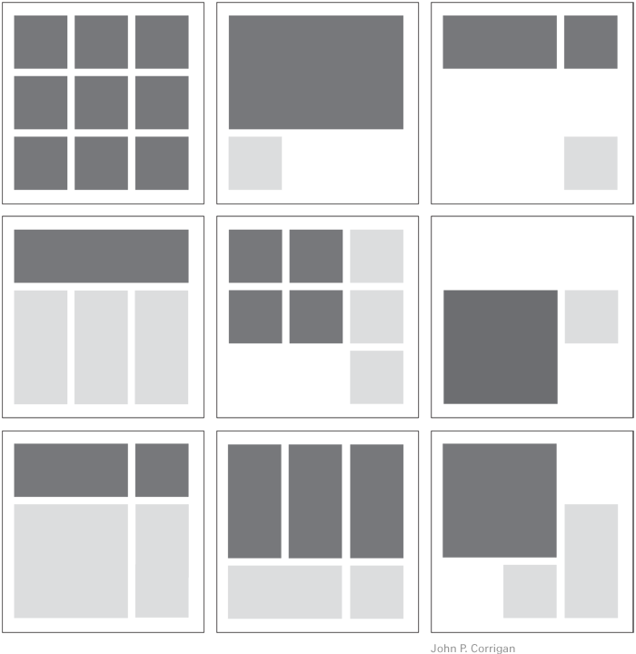
Layout -
Sketch your underlying grid
Are similar things aligned?
White space
Gutters
Flow
Directing the eye
Details matter
A tiny nudge makes a difference
Look at it in a mirror
Squint

Slide 8
Good Design
Hierarchy grid
color
font

Slide 9
Design Dissection
Where does your eye go?
What is the visual hierarchy and how were these elements used to create that?
Contrast
Fonts
Colors
Grids
Layout
Grid
White space
Directing the eye

Slide 10
Design Dissection
Poster Design script from lecture 4.7
Separate attachement

